Slide 1

System Requirements to Install StackStorm
NarendraP
StackStorm: Event-Driven Automation Tool for DevOps and Infrastructure

Slide 2

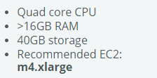
System Requirements
StackStorm officially runs under Linux 64-bit only.
They are:
Ubuntu Linux
RHEL or CentOS Linux.
Note: It is not supported on any other Linux distributions.
System Requirements for Testing:
We need Additional RAM for Data Center Automations
If file system is spited into participations and mount points then we need 1Gb for /var and 1GB for /opt
StackStorm: Event-Driven Automation Tool for DevOps and Infrastructure

Slide 3
Thank you

